Slide 1
Model Legislation Deep Dive
Sam Miller, MPA

Slide 2
Objective
Take a closer look at an example of So Every BODY Can Move model legislation to learn how the initiative accomplishes its state policy objectives.

Slide 3
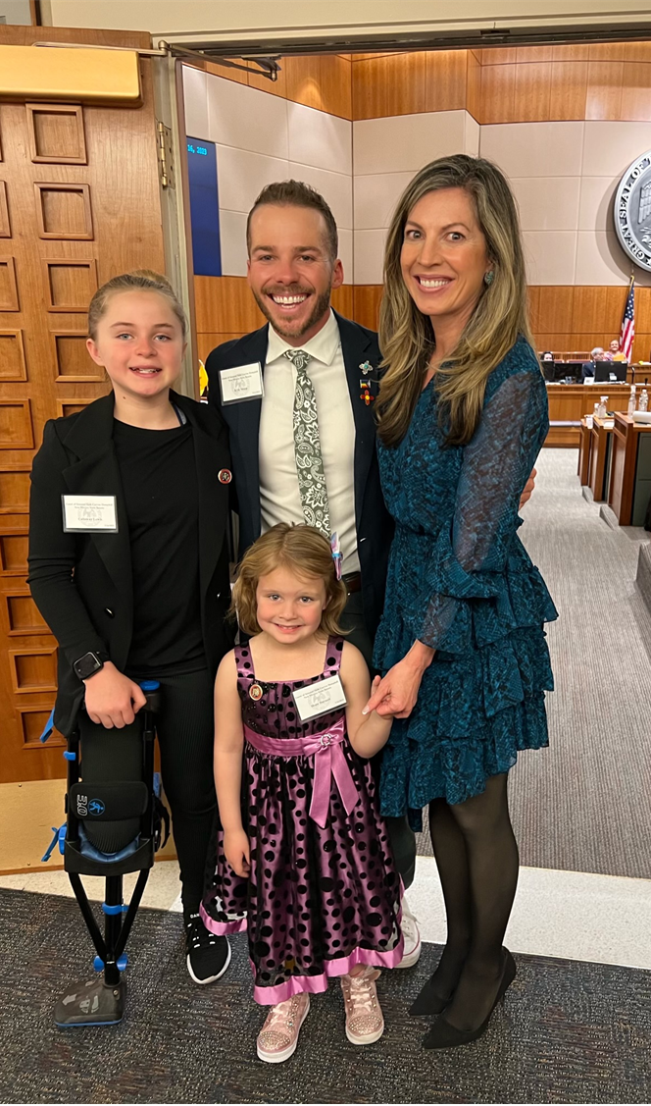
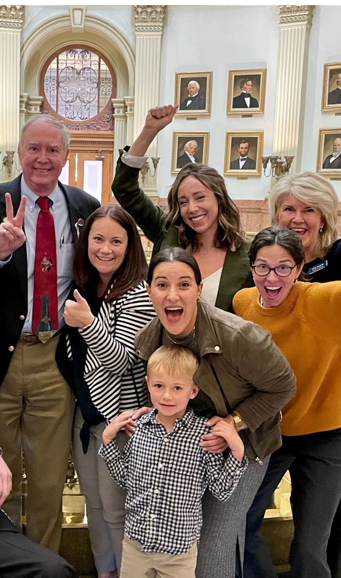
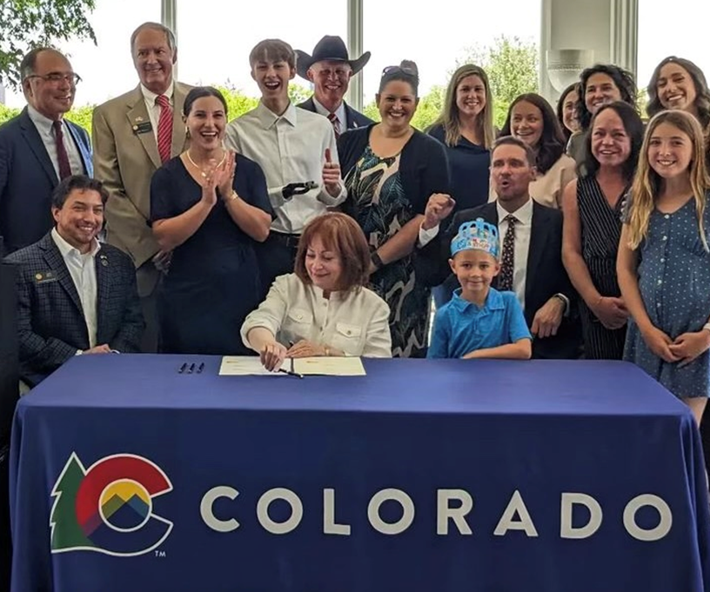
So Every BODY Can Move: At-A-Glance
A national mobility movement powered through state legislative change.
Through So Every BODY Can Move, we will create equitable access to prostheses and orthoses utilized for physical activity as medically necessary healthcare by championing state-by-state legislative change.

Slide 4
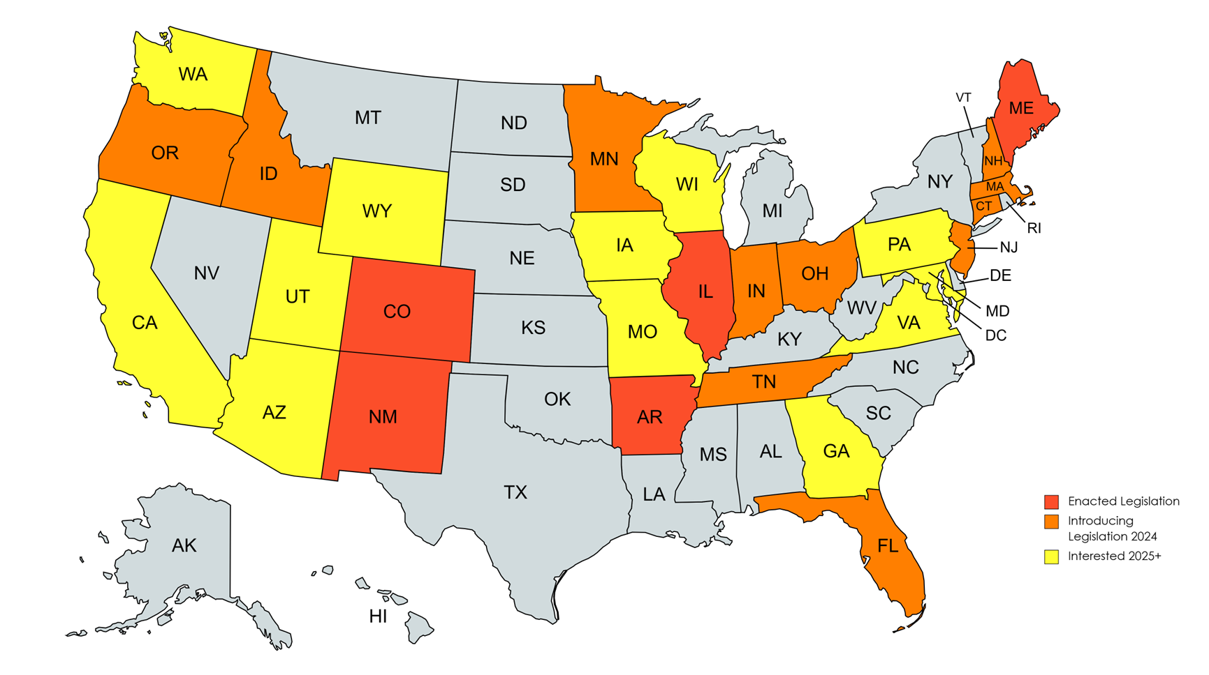
So Every BODY Can Move: At-A-Glance
(as of July 2023)

Slide 5
What is Model Legislation?
A template bill advocates can bring to state legislators in order to:
Communicate the initiative’s main policy objectives
Serve as a starting document that legislators can fit to existing state law

Slide 6
Important Note!
The So Every BODY Can Move model legislation shown in this presentation is just one example of typical provisions that may be included in a bill.
Each state’s bill will be slightly different depending on its political climate, fiscal situation, current statutes, etc.
As the initiative evolves, the model legislation will evolve as well.

Slide 7
An Act to Improve Access to Prosthetic and Orthotic Care for Adults and Children with Limb Loss and Limb Difference
Section 1. Required coverage.
SECTION 2. Medical Necessity and Nondiscrimination Standards for Coverage of Prosthetics or Orthotics.
SECTION 3. Reporting Requirement.
SECTION 4. Application.

Slide 8
An Act to Improve Access to Prosthetic and Orthotic Care for Adults and Children with Limb Loss and Limb Difference
Section 1. Required coverage.
SECTION 2. Medical Necessity and Nondiscrimination Standards for Coverage of Prosthetics or Orthotics.
SECTION 3. Reporting Requirement.
SECTION 4. Application.

Slide 9
An Act to Improve Access to Prosthetic and Orthotic Care for Adults and Children with Limb Loss and Limb Difference
Section 1. Required coverage.
SECTION 2. Medical Necessity and Nondiscrimination Standards for Coverage of Prosthetics or Orthotics.
SECTION 3. Reporting Requirement.
SECTION 4. Application.

Slide 10
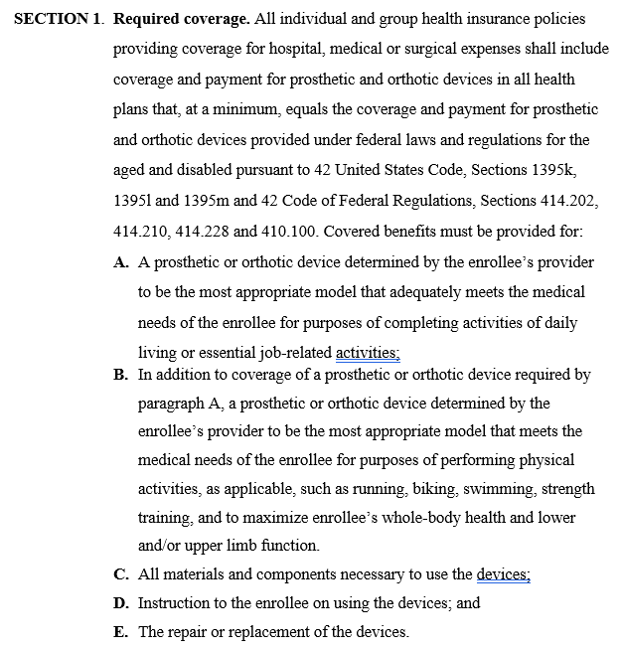
Section 1
Insurance Fairness: Requires state commercial plans to cover and reimburse O&P care at a level at least equivalent to Medicare
Requires state commercial plans to cover activity-specific O&P care
Requires state commercial plans to cover O&P componentry, repairs/replacements, and provide instructions on use

Slide 11
An Act to Improve Access to Prosthetic and Orthotic Care for Adults and Children with Limb Loss and Limb Difference
Section 1. Required coverage.
SECTION 2. Medical Necessity and Nondiscrimination Standards for Coverage of Prosthetics or Orthotics.
SECTION 3. Reporting Requirement.
SECTION 4. Application.

Slide 12
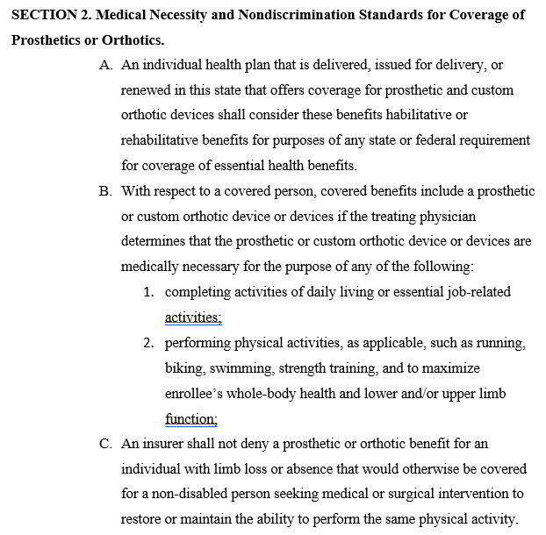
Section 2
Considers O&P care as an “Essential Health Benefit” (EHB) under the Affordable Care Act
Ensures that states do not have to defray costs for insurers providing O&P care
Requires that both “everyday” and activity-specific O&P care must be covered if the treating physician deems it medically necessary
Prohibits insurers from denying activity-specific O&P care that would otherwise be provided to a patient without LL/LD to perform the same activity

Slide 13
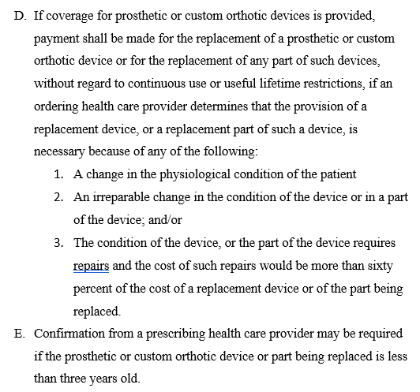
Section 2
Exempts O&P from Reasonable Useful Lifetime (RUL) restrictions in the case of changing patient condition and/or device wear-and-tear (given proper documentation)

Slide 14
An Act to Improve Access to Prosthetic and Orthotic Care for Adults and Children with Limb Loss and Limb Difference
Section 1. Required coverage.
SECTION 2. Medical Necessity and Nondiscrimination Standards for Coverage of Prosthetics or Orthotics.
SECTION 3. Reporting Requirement.
SECTION 4. Application.

Slide 15
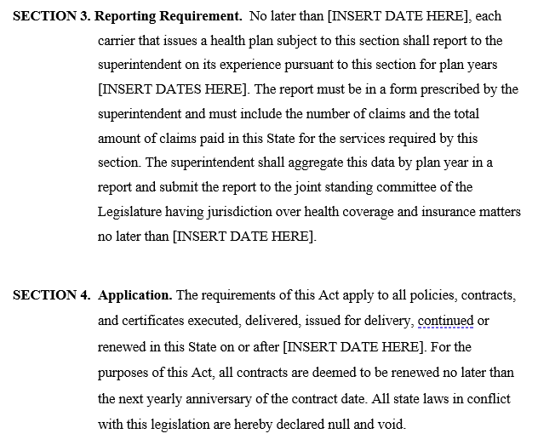
Sections 3 & 4
Requires that insurers subject to the legislation submit a report of claims data to the state’s insurance agency
Sets the timeline for legislative implementation

Slide 16
Questions?
For more information: smiller@AOPAnet.org

